Slide 1
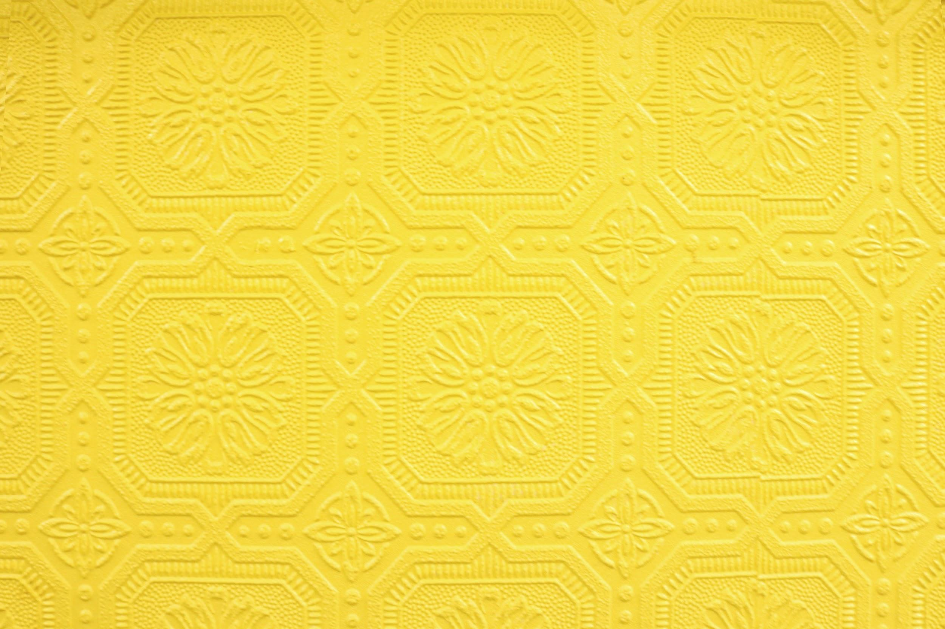
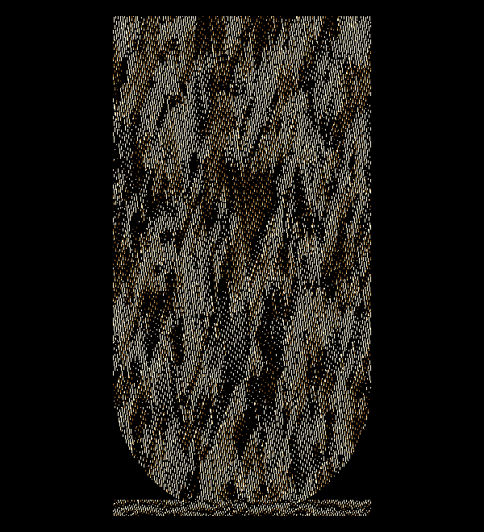
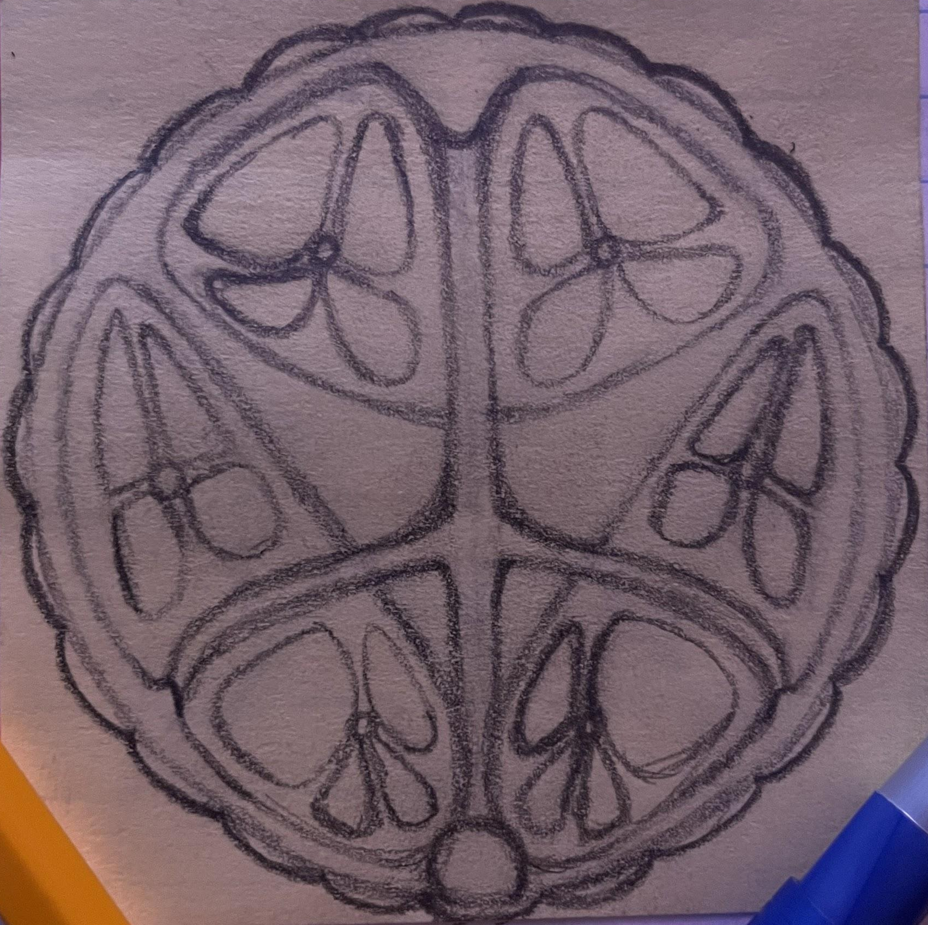
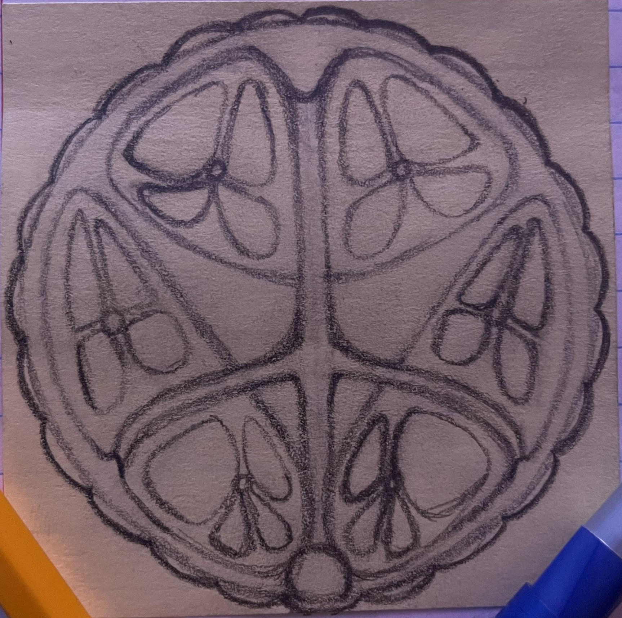
Upload your final draft in the space below. If using a photo, make sure it is straight on with good lighting
Title | Limitations
Style of Art | Korean Hanbok

Slide 2
Museum Placard
In my artwork, I am trying to put on display the disappointing reality of how small thing really are. This is represented by emphasizing the butterfly looking designs being trapped and cramped inside a space and how it all stems from one small point. The size of things are important to me because I feel the world would be much more interesting if it were supersized, but grandeur scenes being painted on the Earth anywhere you look is being clipped just short by the unwanted limitations of size which will forever suppress such fantasies.
Cultural Acknowledgement
Write a paragraph addressing the following questions. Are you using an art form from or inspired by a specific culture? What is the significance of the art form to that culture? How is that related to your project? How did you avoid appropriation? Delete these questions once you answer. My piece of artwork is loosely based on the Korean Hanboks. These are pieces of attire traditionally worn in Korea for formal or semi-formal occasions. The Hanboks used to be fine clothing only worn by the upper class. These are generally made of bright colors and have symbols representing various different themes. This is related to my project because I used the idea of the Korean Hanbok as inspiration to connect a simple design to a much larger idea. Obviously there are clear differences between my hanbok inspired piece and the actual Korean designs which have been passed down for centuries, this is expected as I am not trying to copy the Hanbok symbols nor use my artwork as a substitute to be put on clothing like the Hanbok, I just loved the idea of the small and simple shape representing more than you might expect and wanted to incorporate that into a piece of art.

Slide 3
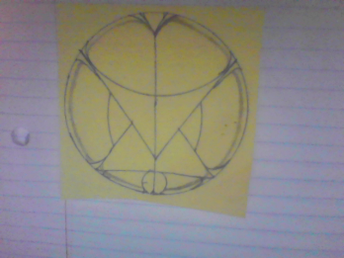
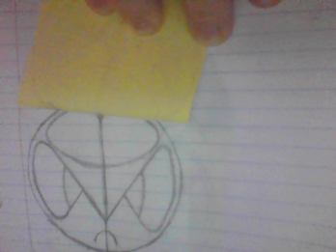
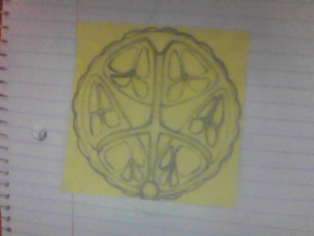
My Progress
Upload pictures representing the evolution of your art. You can add extra boxes if you need to. The idea is to show your growth
Upload sketch
Upload rough draft
Upload final draft
Describe how your project improved throughout the phases
My project improved throughout the phases by going from my first draft showing a completely different picture than the final and having minimal connections between the shapes making the whole image and message harder to see. This then moved onto an overall smoother, but still not complete picture which made the overall flow better and helped lay down the stepping stones for the final draft. The last and final improvement really tied all the loose ends of the piece together by having everything meet back to the center line with a more connected and captivated feel throughout the whole thing.

Slide 4
Mathematical Annotation: Reflection On a picture/screenshot of your final draft, highlight a reflection. Add detail to show how you know it is a reflection.
Mathematical Description: Reflection Write a precise and mathematical description of the reflection above. Explain how you know it is an accurate reflection.
There is reflective symmetry along the y-axis with the butterfly shapes, the veins of the bubbles running together, the circle, and the outer border.

Slide 5
Mathematical Annotation: Translation On a picture/screenshot of your final draft, highlight a translation. Add detail to show how you know it is a translation.
Mathematical Description: Translation Write a precise and mathematical description of the translation above. Explain how you know it is an accurate translation.
There is translation symmetry in the small orbs at the center of the butterfly shapes.

Slide 6
Mathematical Annotation: Rotation On a picture/screenshot of your final draft, highlight a rotation. Add detail to show how you know it is a rotation.
Mathematical Description: Rotation Write a precise and mathematical description of the rotation above. Explain how you know it is an accurate rotation.
There is rotational symmetry in the outer ring of the piece which involves many small uniform half ovals.

Slide 7
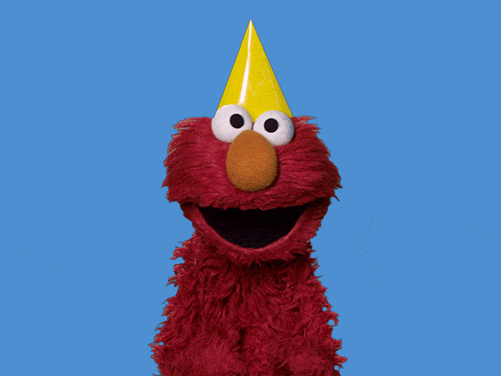
YAY!!!! Almost Done!!!
Double-check your work. Add more slides if you want to show more photos of your work. If you want to annotate additional transformations, copy the slides. Show what you know!
Do you want to try to submit your artwork for publication? Yes or No
Yes if I clean it up and add some color.
What suggestions do you have for improving this project in the future?
I had a hard time pinning down exactly what I wanted to do and what I wanted my final draft to look like, a more detailed organizer towards the beginning might have helped but my project came out how I wanted regardless of how organized I was so I’m not sure.

