Slide 1

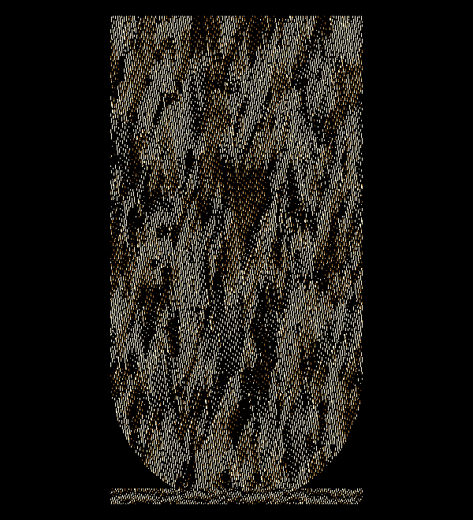
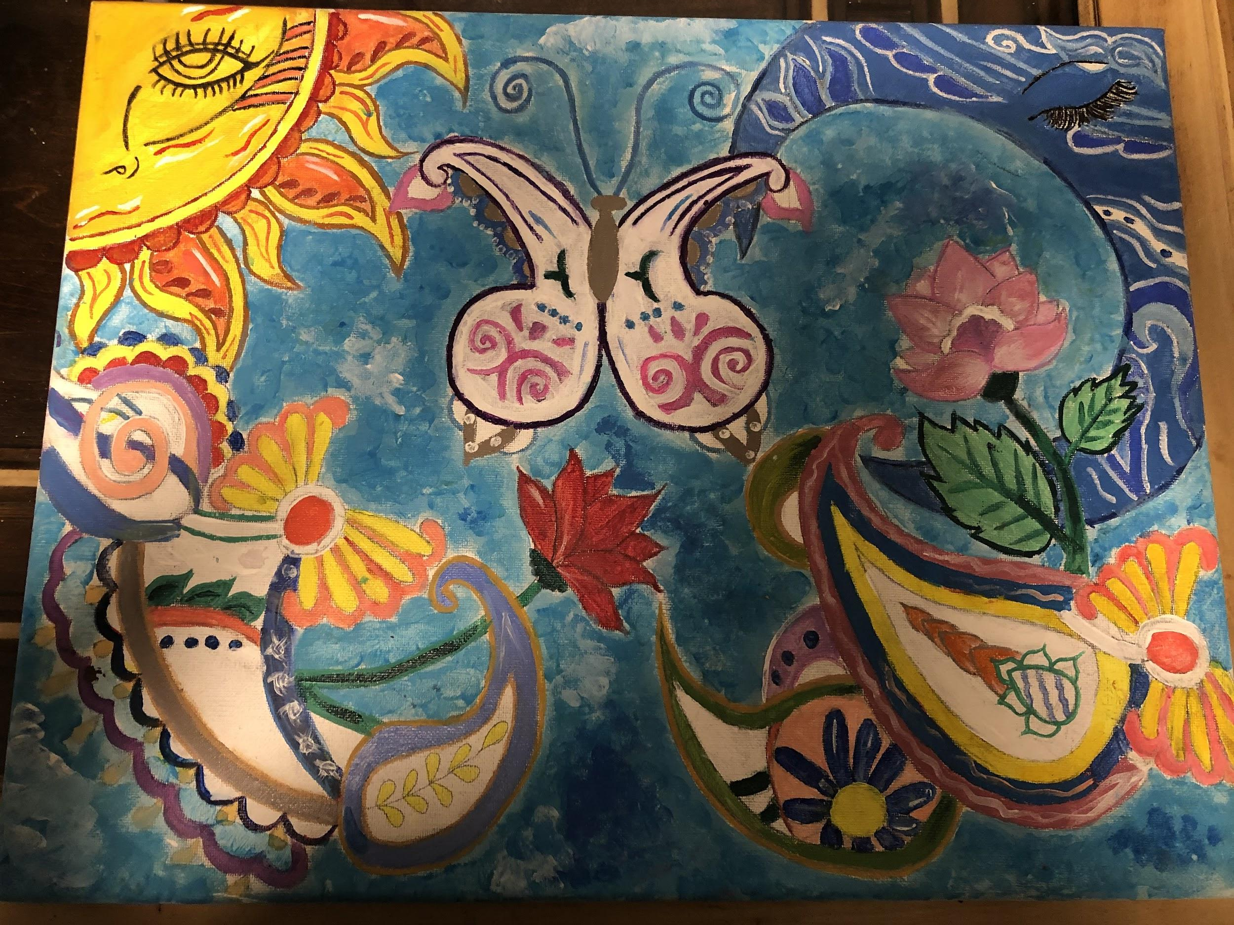
Upload your final draft in the space below. If using a photo, make sure it is straight on with good lighting
Title | THE HIDDEN BEAUTY
Style of Art | paisley

Slide 2
Museum Placard
The idea i was trying to represent in this artwork was to see the hidden beauty from inside as in what people don't see in a person . How i showed what i was trying to say was with the moon and the sun and the butterfly as how their beauty always pops up . It is important to me because i am trying to show people that there's more in a person and they should not judge .
Cultural Acknowledgement
I only used the color of paisley designs that i looked up that would stand out . the paisley represents life and eternity which in my art project was represented with the sun and moon as days and nights i really do not know how to explain it.

Slide 3
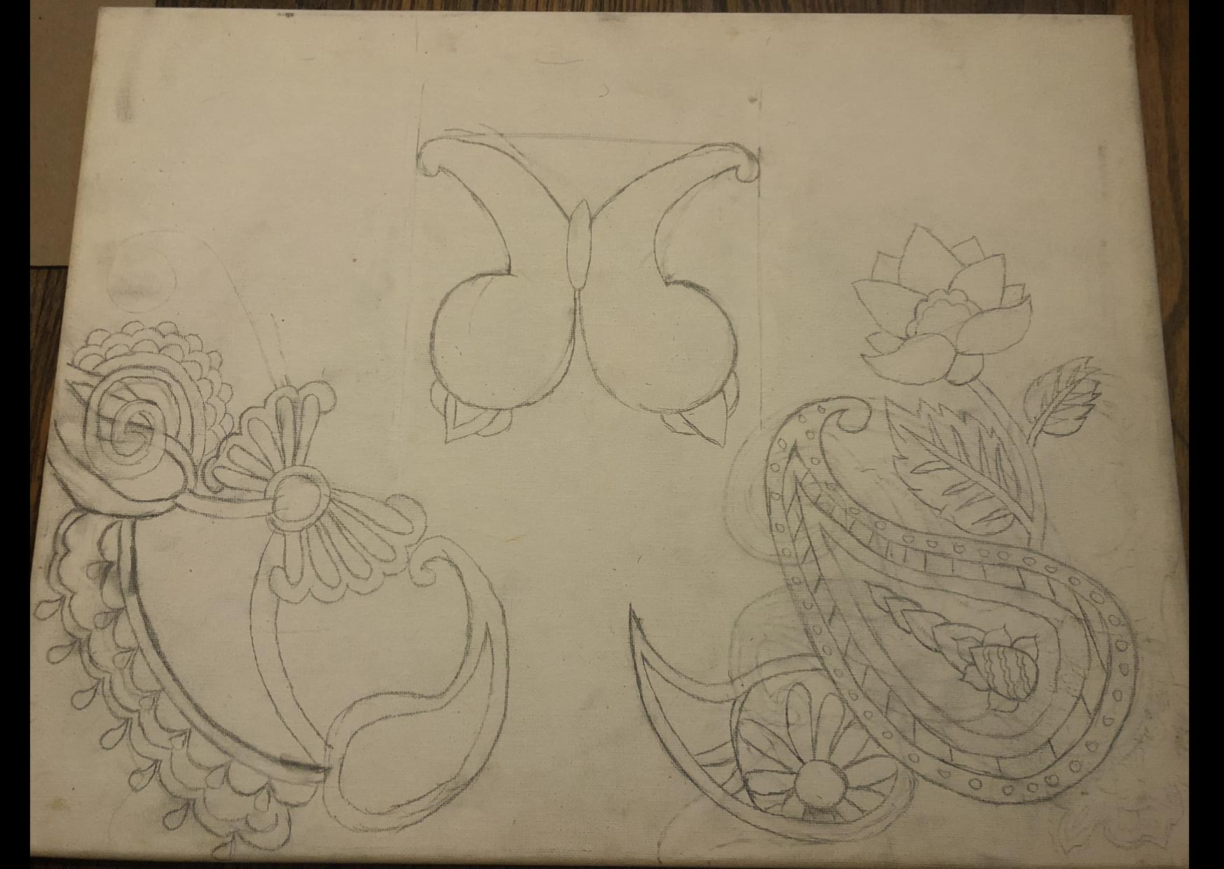
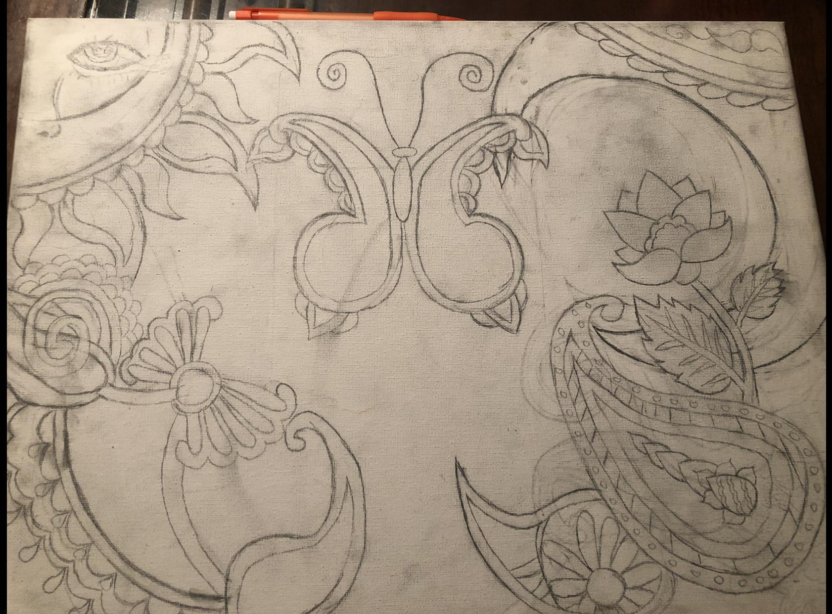
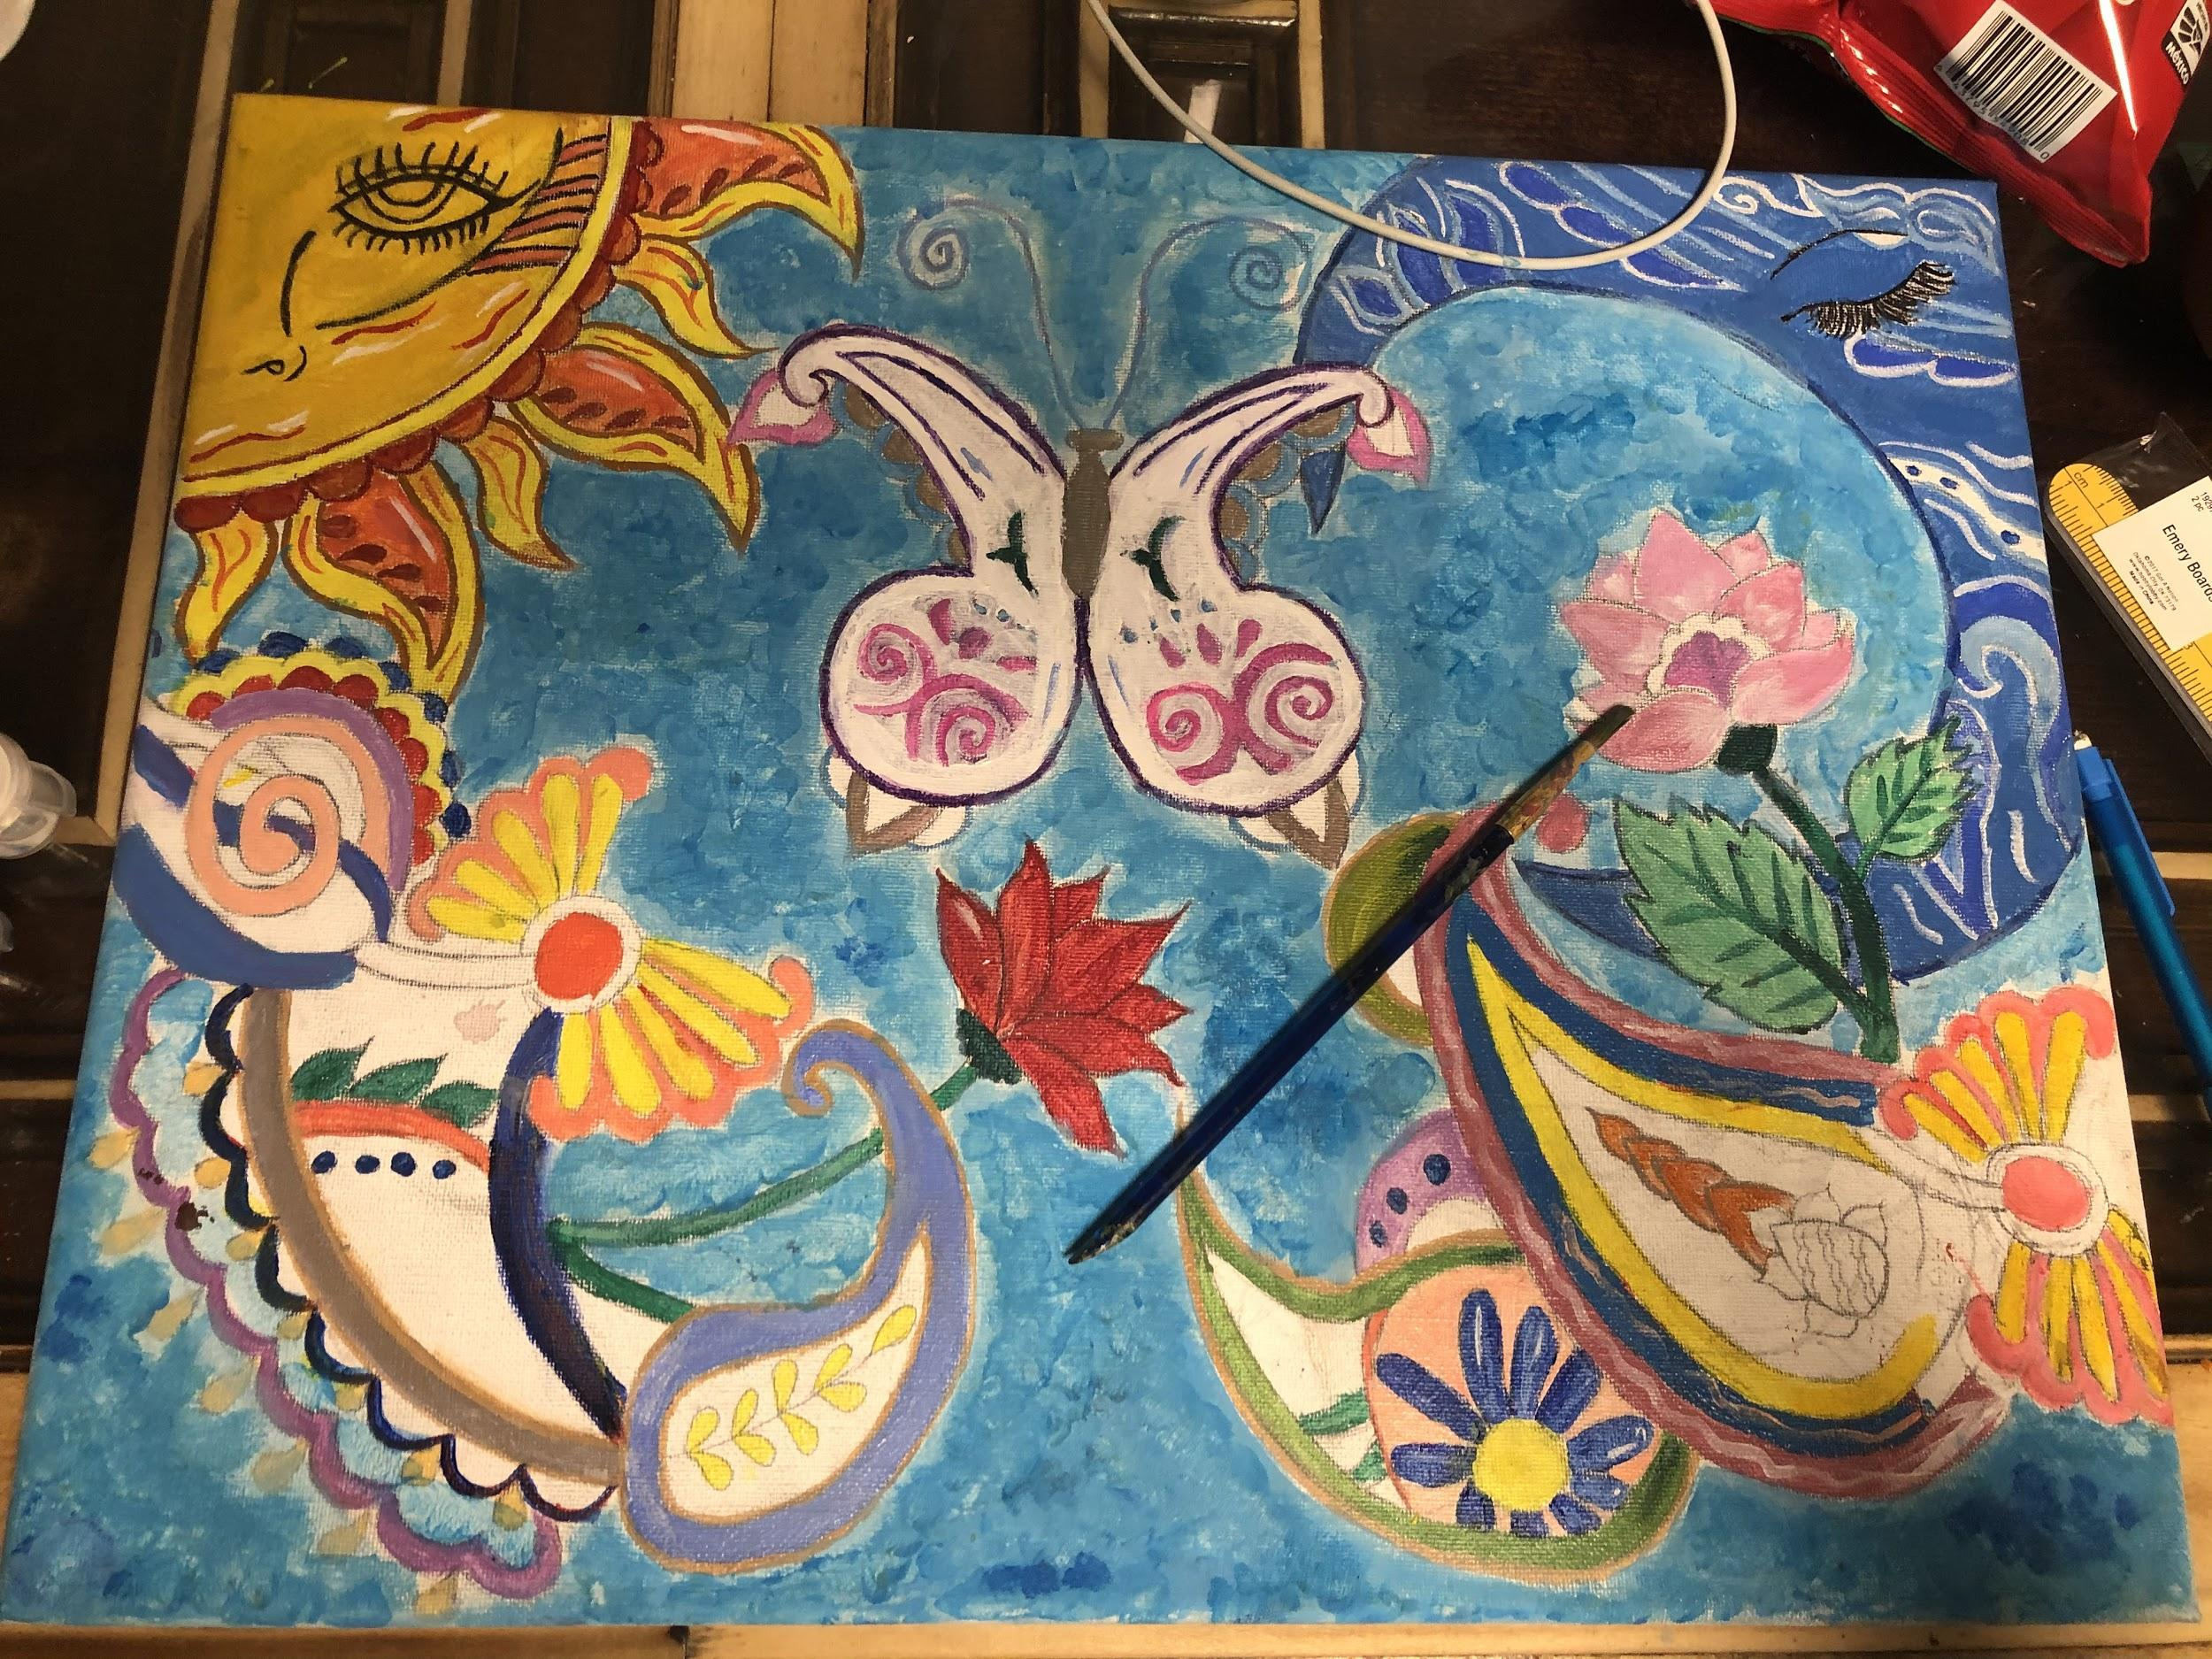
My Progress
Upload pictures representing the evolution of your art. You can add extra boxes if you need to. The idea is to show your growth
Upload sketch
Upload rough draft
Upload final draft
Describe how your project improved throughout the phases
My project improved on how i was trying to make it look on the first one i was looking on what kind of design would look go on them and in the second one i realized my title was the hidden beauty so i had to add some designs so it would go with what i had and the final one i was just looking one which colors that i had to get so it would stand out

Slide 4
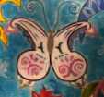
Mathematical Annotation: Reflection On a picture/screenshot of your final draft, highlight a reflection. Add detail to show how you know it is a reflection.
Mathematical Description: Reflection Write a precise and mathematical description of the reflection above. Explain how you know it is an accurate reflection.
The butterfly design has reflection symmetry across the dotted green line.

Slide 5
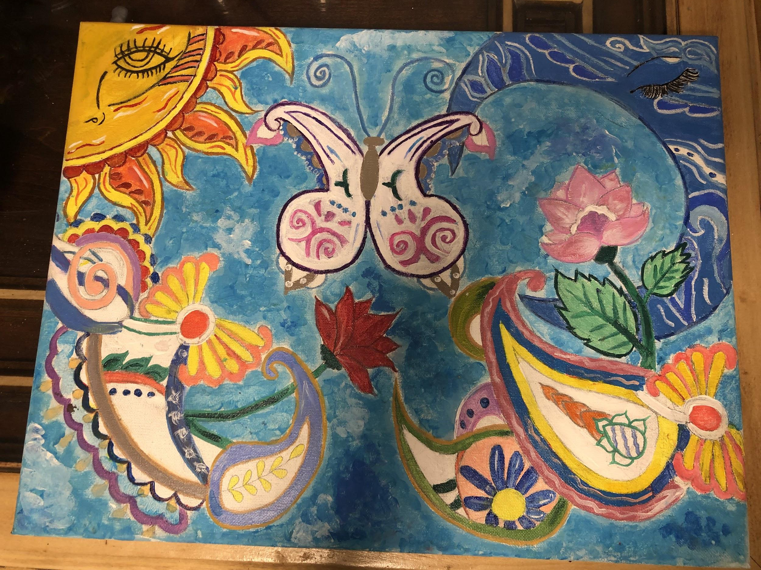
Mathematical Annotation: Translation On a picture/screenshot of your final draft, highlight a translation. Add detail to show how you know it is a translation.
Mathematical Description: Translation Write a precise and mathematical description of the translation above. Explain how you know it is an accurate translation.
The bird is translated down 2.5 iinch and to the right 9 inches.
2.5
9

Slide 6
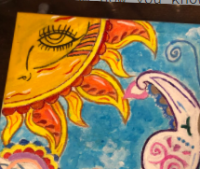
Mathematical Annotation: Rotation On a picture/screenshot of your final draft, highlight a rotation. Add detail to show how you know it is a rotation.
Mathematical Description: Rotation Write a precise and mathematical description of the rotation above. Explain how you know it is an accurate rotation.
The flame was rotated 75 degrees counterclockwise around the top corner of the painting

Slide 7

YAY!!!! Almost Done!!!
Double-check your work. Add more slides if you want to show more photos of your work. If you want to annotate additional transformations, copy the slides. Show what you know!
Do you want to try to submit your artwork for publication? Yes or No
Yes
What suggestions do you have for improving this project in the future?
Something that i would improve on my project was trying to get more designs to put in their and other colors that would match with the whole project.

